Slide 1
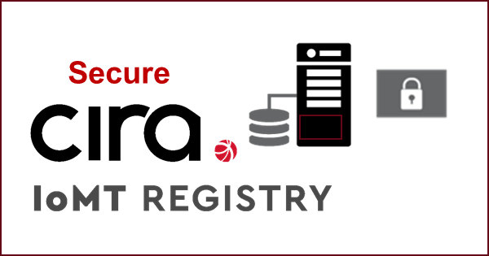
IoT
CIRA Secure IoT Registry
Presented By
Jacques Latour | Natasha D’Souza

Slide 2
Agenda
Evolution & benefits of eSIM
IoT SAFE standards
Opportunities for New Innovation
Hard coded vs Zero Touch
Similarity to Domain Names
What is the IoT Registry?
How does the IoT Registry work?
Smart City example
A New Root of Trust
Progress & Updates

Slide 3
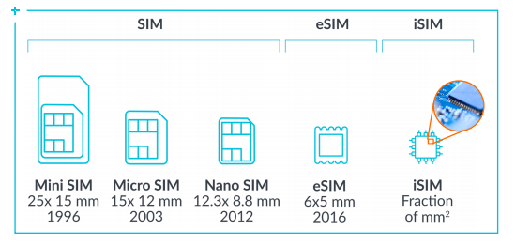
SIM
Have a set of secure credentials stored digitally
They have to be installed and activated in-store
Easy to break/lose
Needs space for physical installation
Have to change SIM cards when changing providers
Physical SIM
vs
eSIM (digital SIM )
eSIM
Allow credentials to be deployed securely over the air i.e. remote (digital) provisioning
Can’t be lost and no in-store visit needed
Save on space as it’s embedded on the device
Reduction of mechanical failures
Change providers remotely
Multiple profiles on one device
Notes:
Link to image - https://images.app.goo.gl/cRdE9xCC98MP1sq88
The SIM card is about identity, like bank cards or modern digital passports
eSIM -deployments provide cost-effective connectivity including flexibility from the selection of operators to the profiles in mobile devices.

Slide 4
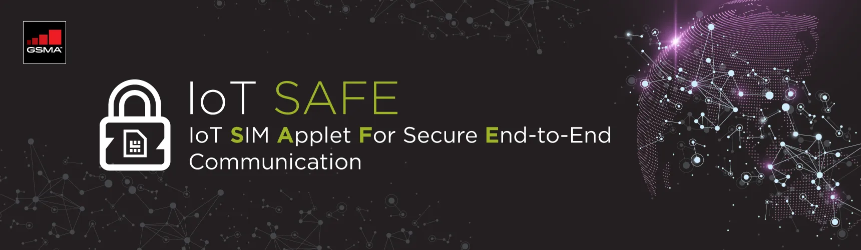
GSMA IoT SAFE
Robust and Effective IoT Security
at Scale for IoT Device Manufacturers, IoT Service Providers
eSIM is a mini ‘crypto-safe’ inside the device to securely establish a (D)TLS session with a corresponding application cloud/server
Leveraged as a hardware Root of Trust by IoT Devices
Enables remote provisioning of Trillions of IoT Devices
Securely perform mutual (D)TLS authentication to a server using either asymmetric or symmetric security schemes
IoT devices to compute shared secrets & keep long-term keys secret
Provisioning and credential lifecycle management from a remote IoT security service
Remote eSIM Provisioning
Notes:
Reference link - https://www.gsma.com/iot/iot-safe/

Slide 5
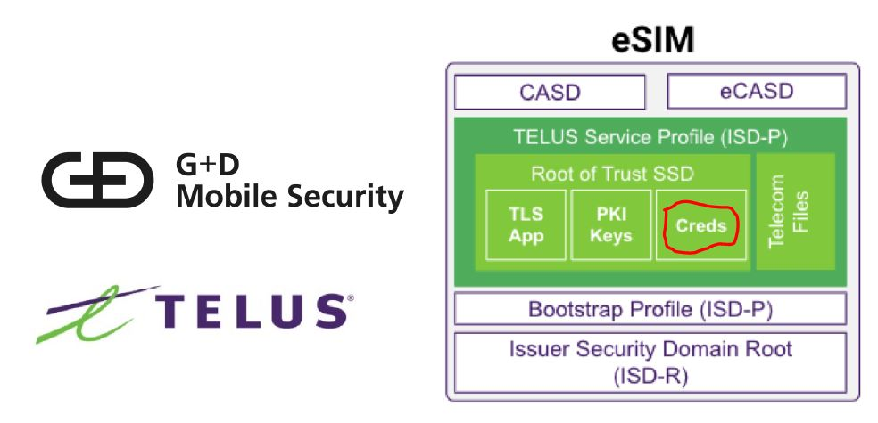
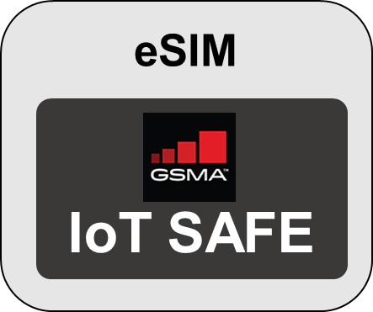
Enabling IoT connectivity
eSIM & MNO service profile
Downloadable Encrypted
IoMT Application Credentials
Application/Cloud Service Provider
Domain name / URL
Port Number
IoT Unique Certificate

Slide 6

IoT Turning Point: Hardcoded vs. Zero Touch
Today - Hardcoded
Mobile (5G)
IoT Devices
Cloud Application
think 5G mobile IoT sensors on a pipeline or
generic smart parking meters
Notes:
The current IoT industry and ecosystem isn't going to scale nicely.
The oncoming 5G revolution will lead to a proliferation of billions of devices around the world.
The IoT industry has the same problem the internet had 50 years ago.
At first, the entire Internet was hard-coded. All the websites and their addresses lived in one file.
Then, 20 years in, we developed the modern DNS to help solve that problem so the internet could scale.
For the last 30 years we've enjoyed the benefits of this.
Right now the IoT ecosystem is largely based on a hard-coded reference model.
We have developed an IoT framework that is "zero-touch" and highly scalable.
EXPLAIN THE DIAGRAM.
Hard-coded:
Doesn't scale
Manual
Touch each device
Insecure
Error prone
Zero-touch
Automatic configuration
Secure
Zero touch
Scalable to billions

Slide 7

IoT Turning Point: Hardcoded vs. Zero Touch
Today - Hardcoded
Mobile (5G)
IoT Devices
Cloud Application
Future (5G) – Zero Touch
Mobile (5G)
IoT Devices
Cloud Applications
Notes:
The current IoT industry and ecosystem isn't going to scale nicely.
The oncoming 5G revolution will lead to a proliferation of billions of devices around the world.
The IoT industry has the same problem the internet had 50 years ago.
At first, the entire Internet was hard-coded. All the websites and their addresses lived in one file.
Then, 20 years in, we developed the modern DNS to help solve that problem so the internet could scale.
For the last 30 years we've enjoyed the benefits of this.
Right now the IoT ecosystem is largely based on a hard-coded reference model.
We have developed an IoT framework that is "zero-touch" and highly scalable.
EXPLAIN THE DIAGRAM.
Hard-coded:
Doesn't scale
Manual
Touch each device
Insecure
Error prone
Zero-touch
Automatic configuration
Secure
Zero touch
Scalable to billions

Slide 8
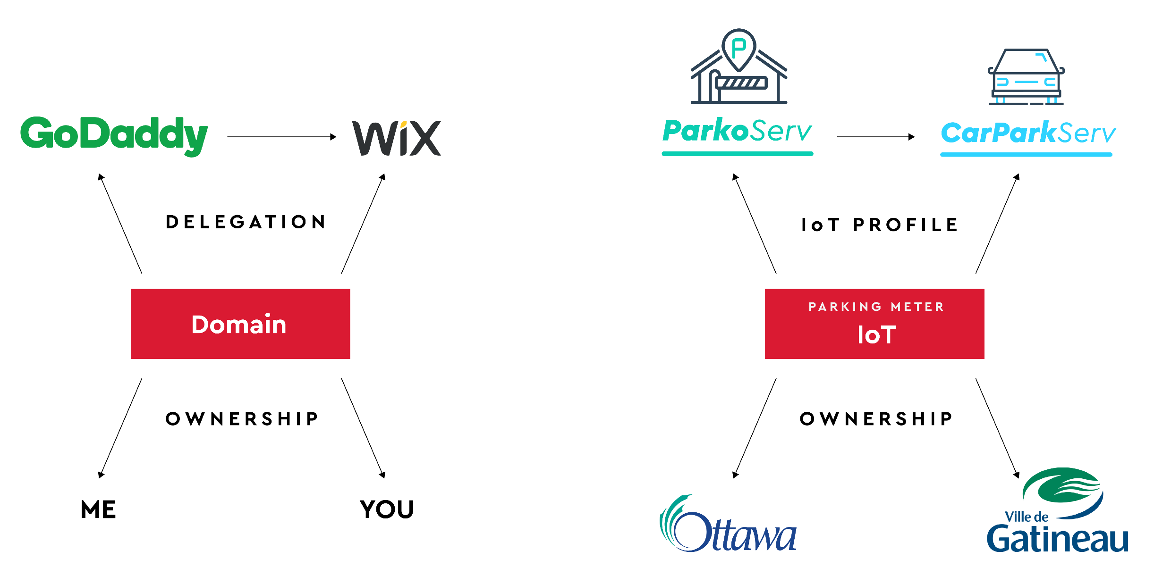
Domain Names & IoT Devices are similar
Application Service Providers
Notes:
To make this happen, though, you need a registry at the centre.
As a bit of background: CIRA’s primary responsibility is to run a Registry that manages the .CA domain.
If you think about it, names are a lot like IoMT devices.
A domain name has an owner, and the owner can point that domain to any website on the internet. E.g. l-spark.ca can point to a unique page about the program, or it could point it to something completely different. It’s totally up to the end user.
Similarly, an IoMT device has an owner, and the owner can make that device work with any application. So the sensor on my front door can point to AlarmForce’s home security service, or ADT’s service.

Slide 9

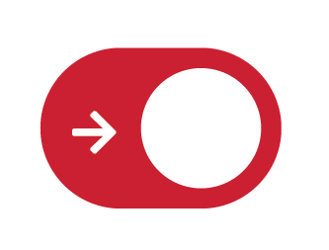

Registration
Activation
Transfer
Zero Touch
WWW.CIRA.CA
IoT
Notes:
What is the IoT Registry?
Registration of the IoT device onto the network
Activation of this IoT with the ASP
Transfer of IoT device between ASPs

Slide 10

Customer
Facilitates
Secure Connectivity
Application
Service Providers (ASP)
Generic
IoT Device
Customer
Generic Mobile IoT Device
Customer
Generic Mobile IoT Device
eSIM
eUICCID/eID
public keys
IoT SAFE
IoT
IoTSAFE
Mobile
Network Operators (MNO)
Over the air
provisioning
Notes:
The key is eSIM-equipped, generic IoT devices that work with anything.
This way application and cloud service providers can just focus on the app or service and don't have to worry about the devices.
Let application developers focus on the apps, and device manufacturers focus on the devices.

Slide 11



THE CITY OF OTTAWA BUYS 1000 GENERIC SMART PARKING METERS AND SELECTS PARKOSERV AS CLOUD SERVICE PROVIDER

Slide 12
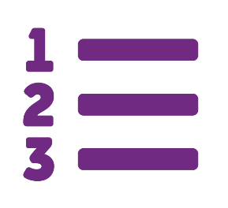
1 - Procurement
Purchases 1000 SParkometers
(generic smart parking meters)
City of Ottawa
1
Provides
eUICCID/eID
public keys
City of Ottawa
Sparkometer
eSIM
PUB
PRI
IoT Security Applet
IoT
MNO

Slide 13
Registration
WWW.CIRA.CA
Zero Touch
Activation
Transfer
Notes:
What is the IoT Registry?
Registration of the IoT device onto the network
Activation of this IoT with the ASP
Transfer of IoT device between ASPs

Slide 14
2 - Cloud Registration
City of Ottawa registers 1000 new generic SParkometer with ParkoServ
City of Ottawa
2
Provides
eUICCID/eID
public keys
City of Ottawa
Sparkometer
eSIM
PUB
PRI
IoT Security Applet
IoT
MNO

Slide 15

City of Ottawa
3 - IoT Registry Registration
ParkoServ registers 1000 SParkometer with the CIRA Secure IoT Registry
City of Ottawa
Sparkometer
3
Provides
eUICCID/eID
public keys
eSIM
PUB
PRI
Client CERT
IoT Security Applet
PRI
1000 IoT
IoT
Creates
Encrypted IoT Profile with unique IoT device certificate and ParkoServ connection information (URL, PORT)
Destruction of keys
MNO

Slide 16
Registration
WWW.CIRA.CA
Zero Touch
Activation
Transfer
Notes:
What is the IoT Registry?
Registration of the IoT device onto the network
Activation of this IoT with the ASP
Transfer of IoT device between ASPs

Slide 17
City of Ottawa
4 - IoT Device Provisioning
IoT Registry provides MNO with the encrypted IoT Profile to each of the ParkoServ registered 1000 SParkometer
City of Ottawa
Sparkometer
Provides
Status
eSIM
PUB
PRI
Client CERT
IoT Security Applet
PUB
PRI
1000 IoT
IoT
Client CERT
Provides
eUICC status
Encrypted IoT Security Applet
PUB
PRI
4
4
Provides
eUICC Profile
Secure transmission of IoT Profile (IoT Security Applet containing Client Cert + info)
MNO

Slide 18
5 - ParkoServ Cloud Connectivity
The SParkometer securely connect to the ParkoServ cloud service in a trusted manner
City of Ottawa
5
Provides
Trusted & Secure TLS/DTLS Connection
City of Ottawa
Sparkometer
Server CERT
Provides
Status
eSIM
PUB
PRI
5
Provides
Certificate authenticity of IoT device certificate and ParkoServ cloud services Server certificate
IoT Security Applet
1000 IoT
IoT
Client CERT
PUB
PRI
MNO

Slide 19

THE CITY OF OTTAWA CHANGES THEIR PARKING CLOUD PROVIDER

Slide 20
Registration
WWW.CIRA.CA
Activation
Zero Touch
Transfer
Notes:
What is the IoT Registry?
Registration of the IoT device onto the network
Activation of this IoT with the ASP
Transfer of IoT device between ASPs

Slide 22



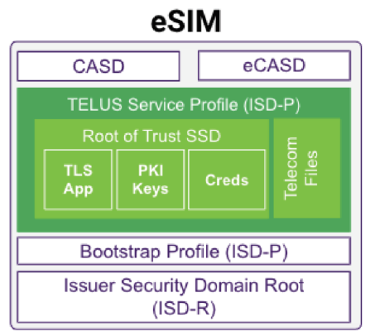
Transfer between providers
Application Service Providers
eSIM
&
MNO profile
Credentials
ParkoServe
iot.parkoserv.ca:8884
IoT Unique Certificate
Credentials
CarParkServ
iot.carparkserv.ca:8883
IoT Unique Certificate
Mobile IoT Device

Slide 23
6 - Cloud Registration
City of Ottawa registers 1000 existing SParkometer with CarParkServ and request a transfer of cloud service provider
City of Ottawa
Provides
eUICCID/eID
public keys
6
City of Ottawa
Sparkometer
eSIM
PUB
PRI
IoT Security Applet
1000 IoT
IoT
Client CERT
PUB
PRI
MNO

Slide 24
7 - IoT Registry Registration & Transfer
CarParkServ request to transfer 1000 SParkometer with the CIRA Secure IoT Registry, the City of Ottawa provides the AuthCodes for the transfer
City of Ottawa
7
Provides
AuthCodes
City of Ottawa
Sparkometer
Provides
eUICCID/eID
public keys
7
eSIM
PUB
PRI
Client CERT
IoT Security Applet
PUB
PRI
1000 IoT
IoT
Client CERT
Creates
New encrypted IoT Profile with unique IoT device certificate and ParkoServ connection information
Destruction of keys
PUB
PRI
MNO

Slide 25
8 - IoT Device Provisioning
IoT Registry provides MNO with the new encrypted IoT Profile to each of the CarParkServ registered 1000 SParkometer
City of Ottawa
City of Ottawa
Sparkometer
Provides
Status
eSIM
PUB
PRI
IoT Security Applet
1000 IoT
IoT
Client CERT
PUB
PRI
8
Provides
eUICC status
Encrypted IoT Security Applet
8
Provides
eUICC Profile
Secure transmission of IoT Profile
(IoT Security Applet containing Client Cert + info)
MNO

Slide 26
9 - CarParkServ Cloud Connectivity
The SParkometer reboot and securely connect to the CarParkServ cloud service in a trusted manner
City of Ottawa
9
Provides
Trusted and Secure TLS/DTLS Connection
City of Ottawa
Sparkometer
Server CERT
Provides
Status
eSIM
PUB
PRI
IoT Security Applet
9
Provides
Certificate authenticity of IoT device certificate and CarParkServ cloud services Server certificate
1000 IoT
IoT
Client CERT
PUB
PRI
MNO

Slide 27
AND VOILA, WITH ZERO TOUCH, THE CITY OF OTTAWA HAS CHANGED CLOUD SERVICE PROVIDER SEAMLESSLY FOR A 1000 SMART PARKING METERS

Slide 28


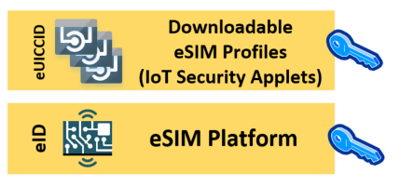


A New Root of Trust - DNSSEC
Public Root
Trust Anchor
And Keys
DNSKEY
Leveraging the public DNS & DNSSEC
to validate the authenticity of
Root
Zone
(.)
DS
eSIM
IoT security applets
cloud service providers public keys
.CA
Zone
DNSKEY
DS
IoTRegistry.CA
Zone
DNSKEY
IoT eSIM
Public Key
DNS
signed

Slide 29
Progress & Next Steps
Partnered with Telus, Blackberry and Solace in L-Spark phase 1
Developing using an IoT Dev Kit with Raspberry Pi, Solace Application Layer, Telus BG66 Module and eSIM
CIRA implemented GSMA 04
CIRA to contribute to GSMA IoT SAFE standard development
Fall 2020 will participate in L-Spark Medtech Accelerator
Notes:
Press - https://www.canhealth.com/2020/08/05/l-spark-accelerator-launches-medtech-program/

Slide 30

Thank You

Slide 31
Questions?

